Slide 1
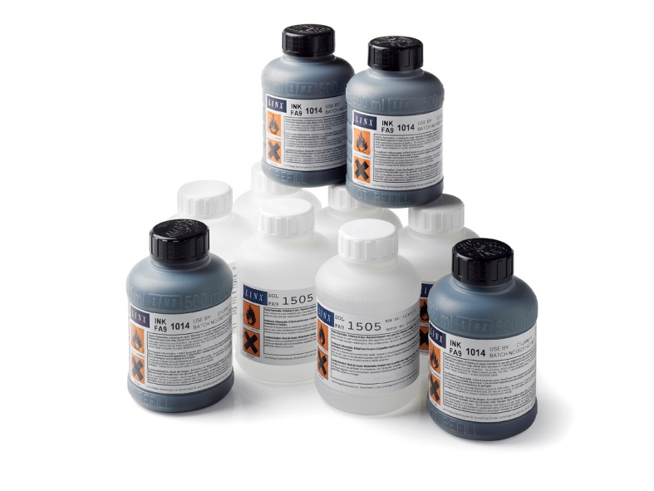

Why Use Linx Original Products?
Maintaining uptime and reliability

Slide 2



Benefits of using Genuine Aftersales Products
Uptime
Print Quality
Compliance
Guarantee and Assurance

Slide 3

Maximum Uptime
“The cost and impact to our operations from just a single unplanned maintenance event resulting from out-of-specification, sub-standard or unproven fluids far exceed the minor amount of perceived savings off-brand supplies may first appear to offer.“

Slide 4

Maximum Uptime
Production line stop
For an average manufacturing company, 10 minutes of downtime can cost more than 1 year’s supply of ink and solvent …
Notes:
Estimation made for a printer consuming per year:
5 litres of ink: 220£
33 litres of solvent : 363 £
Total = 583£
1 hr downtime cost is currently 3500£

Slide 5
Maximum Uptime
A multi-national food processor based in the UK switched their consumables supply to save money, but they found they were spending more on:
  Service costs for ink-related printer failures
  Downtime caused by ink-related printer failures
  Filter changes
To test the difference between Linx ink and the third party ink, they ran two printers side by side, and found:
  Filters needed changing twice as often using third party ink
  Printer failed due to ink-related problems

Slide 6
Print Quality

Slide 7
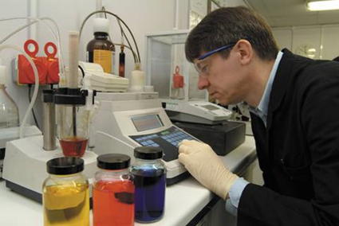
Print Quality
We have tested a number of third party inks, including:
Viscosity (ink thickness) – the ability to form the right sort of drops
Conductivity – the ability of an ink drop to take a charge
Cleanliness (filtration) – the presence of undesirable impurities
Advanced chemical composition analyses – types of chemical present
There is firm evidence to prove that the use of alternative supplier inks or solvents in our printers can affect printer reliability and lead to costly repairs and production line downtime.
This is how the ink suppliers manage
to undercut our prices…

Slide 8
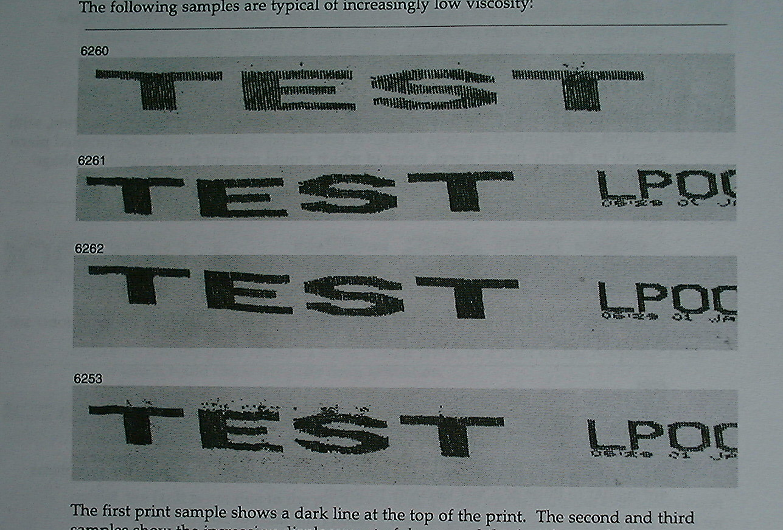
Print Quality
With 3rd party fluids or spares print quality could be adversely affected.
This will impact production costs for rework or recalls of products.

Slide 9


Compliance

Slide 10
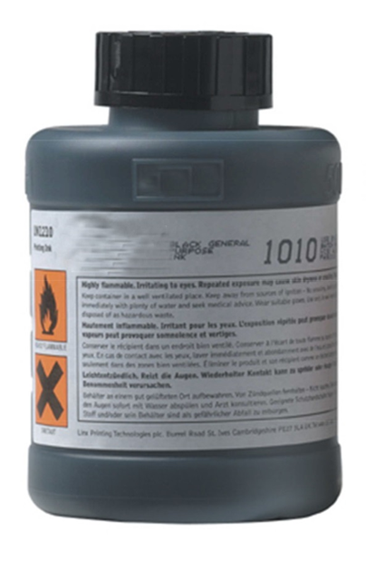
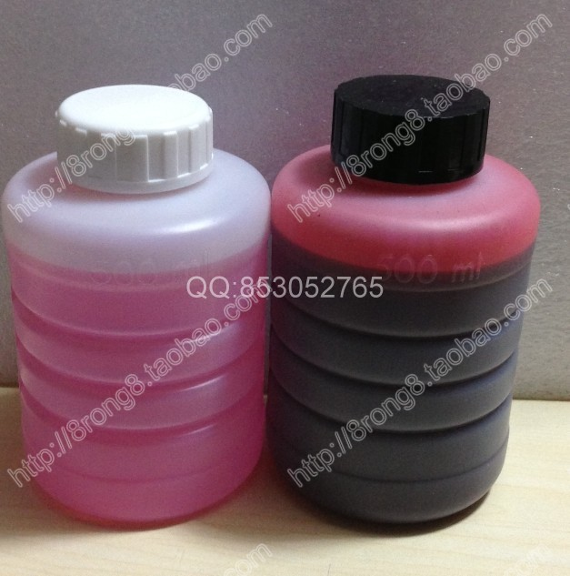
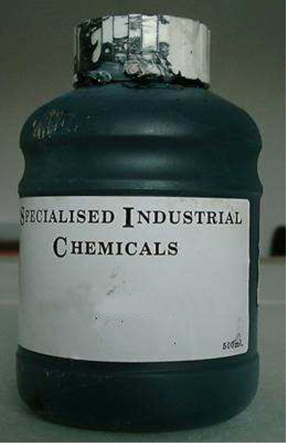
Compliance
Health and safety legislation is often ignored
  Risk of non-compliance with HSE regulations, risk of incorrect precautions regarding flammability, etc, and first aid treatment in the event of operator exposure
  GHS labelling – Risk on non-compliance with global labelling regulations

Slide 11

Guarantee & Assurance

Slide 12
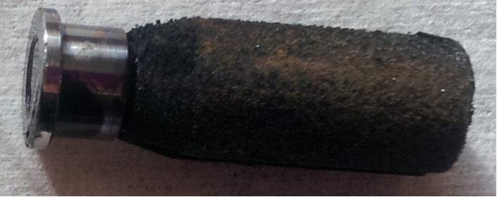
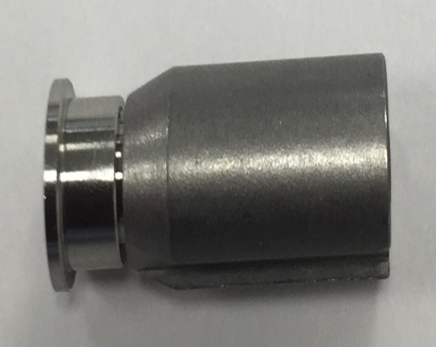
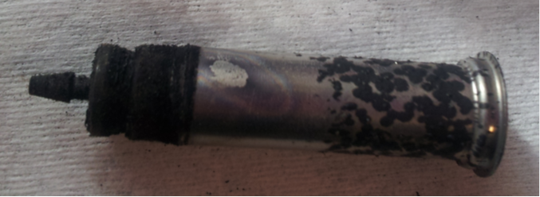
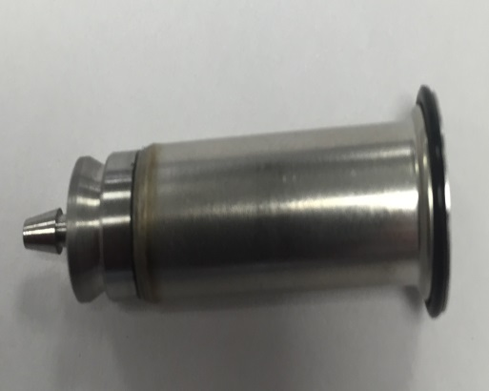
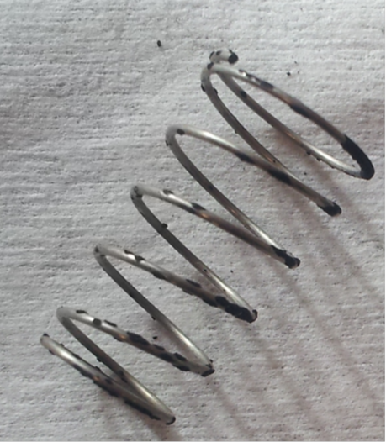
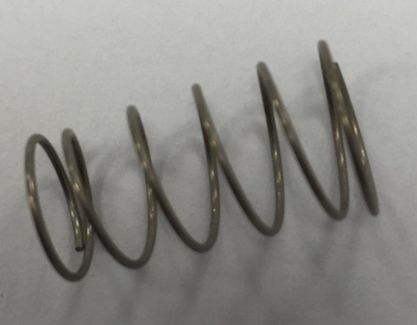
Guarantee and Assurance
With genuine Linx products all fluids and spares are designed to ensure compatibility. Using 3rd party products can lead to damaged ink system valves. Cost of replacement £350 each, may not appear too much.
However
This could well lead to contamination of the rest of the ink system, increased workload on the pump accelerates wearing of the gears. To be certain of clearing this you need
That’s a bill of over £2,200 plus 6 hours lost production time

Slide 13
Cost Of Ownership

Slide 14
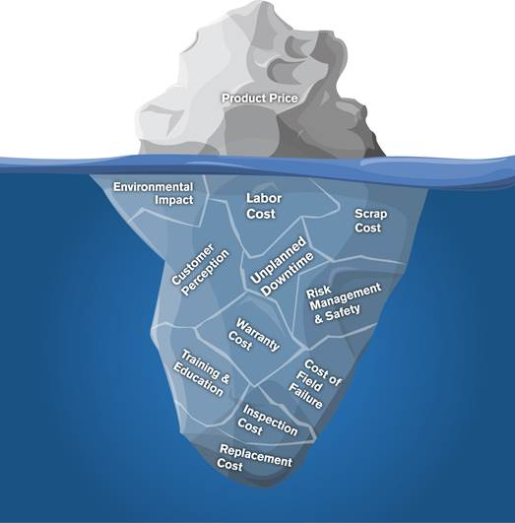
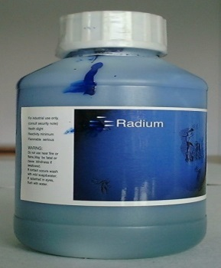
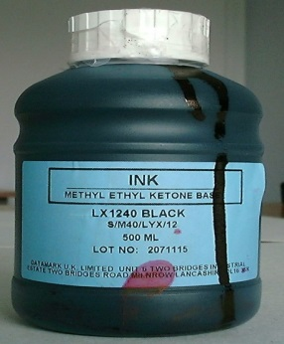
Overall Cost of Ownership
Clogging of nozzles
Clogging of filters
Clogging of ink lines
More frequent maintenance
High frequency of faults
Real health and safety risks
More print head cleans
Deteriorated print quality
Lower colour intensity of codes
Change in dry time of codes

Slide 15
In Summary Genuine Products Provide:
ü | High Performance | Inks and printers are finely matched for optimal performance. Taking up to a year to develop and perfect, ink and make-up fluids are rigorously tested for hundreds of hours over an extreme range of temperature and environmental conditions. Tests confirm operational consistency and printer reliability
ü | Fluids Compatibility | Solvent is formulated to exactly match corresponding ink chemistry. Chemical components lost through normal evaporation and due to printers operating in a wide range of conditions are precisely replenished so your printer doesn’t spend more fluids than necessary
ü | Equipment Compatibility | Fluids formulations are chemically compatible with printers. Compatibility helps against internal corrosion, deterioration and premature parts replacement and therefore minimizes service of critical printer components
ü | Purity | Inks and their raw materials meet purity and filtration standards, thus reducing the risk of contamination that could impede critical printer operation. The smallest of particles can clog nozzles. Ink and make up are filtered up to 8 times to prevent clogging and down time

Slide 16
While 3rd Party products Affect:
✗ | Internal printer corrosion, deterioration | Interferes with the operation of specialized printer components, including; valves, nozzles, pumps and diaphragms – any one of which could result in expensive printer repair costs not covered under warranty
✗ | Contamination | Even small amounts concentrate in the printer over time, resulting in increased downtime, unpredictable component failures, and more frequent maintenance intervals
✗ | Unproved ink/printer combinations | Service technicians unfamiliar with unproven ink/printer combinations are less equipped to evaluate problems and could cause extended troubleshooting, downtime and increased repair costs
✗ | Unknown and hazardous components | Could present risks to your worker’s health and safety and present other hidden environmental safety hazards

